Slide 1

Travel Tourism and Hospitality Systems
Group-555

Slide 2

Choose an Experience
Adventure
Enthusiasm
Discovery

Slide 3
TRAVEL:
Travel is the movement of people between distant geographical locations. Travel can be done by foot, bicycle, automobile, train, boat, bus, airplane, ship or other means, with or without luggage, and can be one way or round trip.^{[1]} Travel can also include relatively short stays between successive movements, as in the case of tourism.
TOURISM:
Tourism is the activities of people traveling to and staying in places outside their usual environment for leisure, business or other purposes for not more than one consecutive year.
HOSPITALITY:
The hospitality industry is a broad category of fields within the service industry that includes lodging, food and drink service, event planning, theme parks, travel and tourism. It includes hotels, tourism agencies, restaurants and bars.

Slide 4
Content outline:
Empathy Map
Customer Journey Map
Persona
User Survey
Understanding The Business System
Identification of Problem Statements
Prerequisites
User Stories

Slide 5
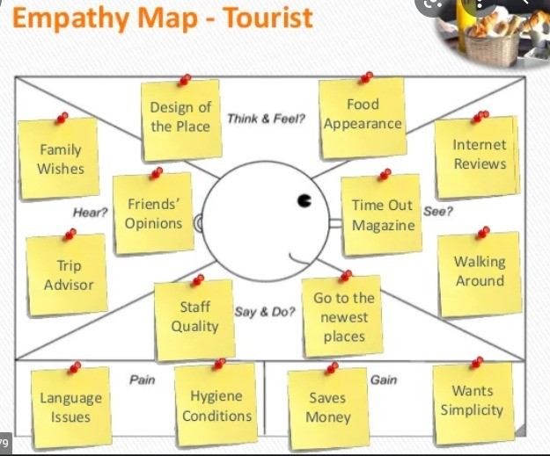
Empathy Map:

Slide 6
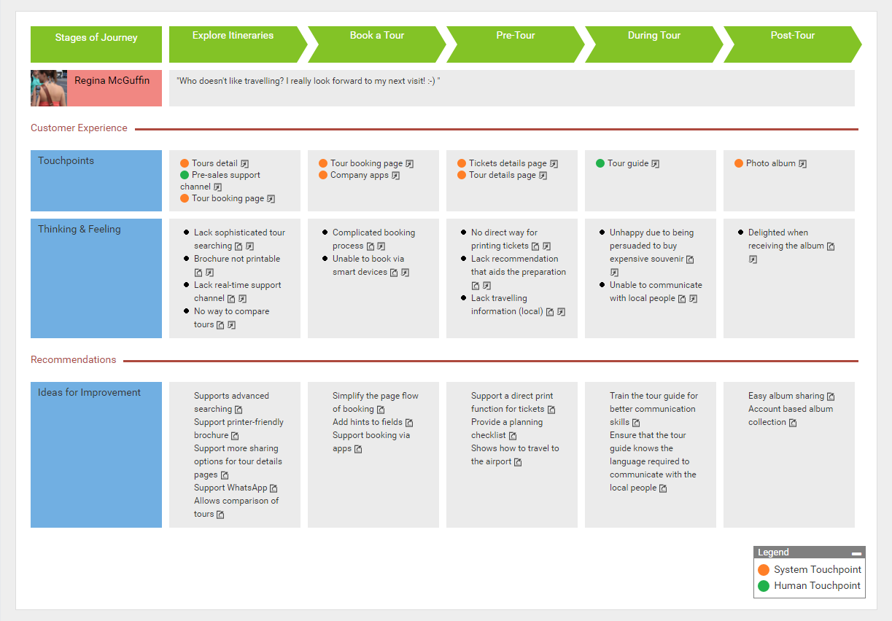
Customer Journey Map:

Slide 7
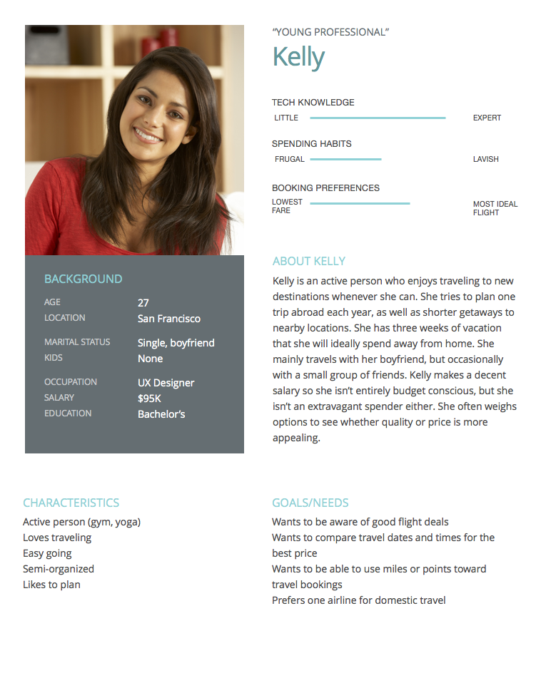
Persona Of a traveler:

Slide 8
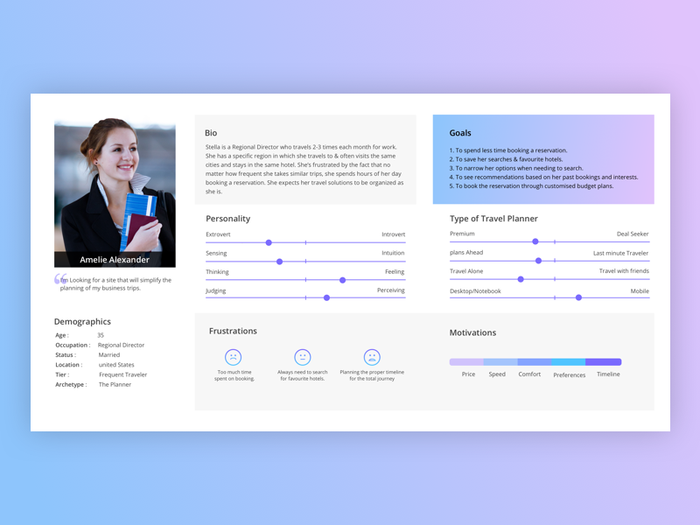
Persona of a Business Man:

Slide 9
Travel Budget

Slide 10
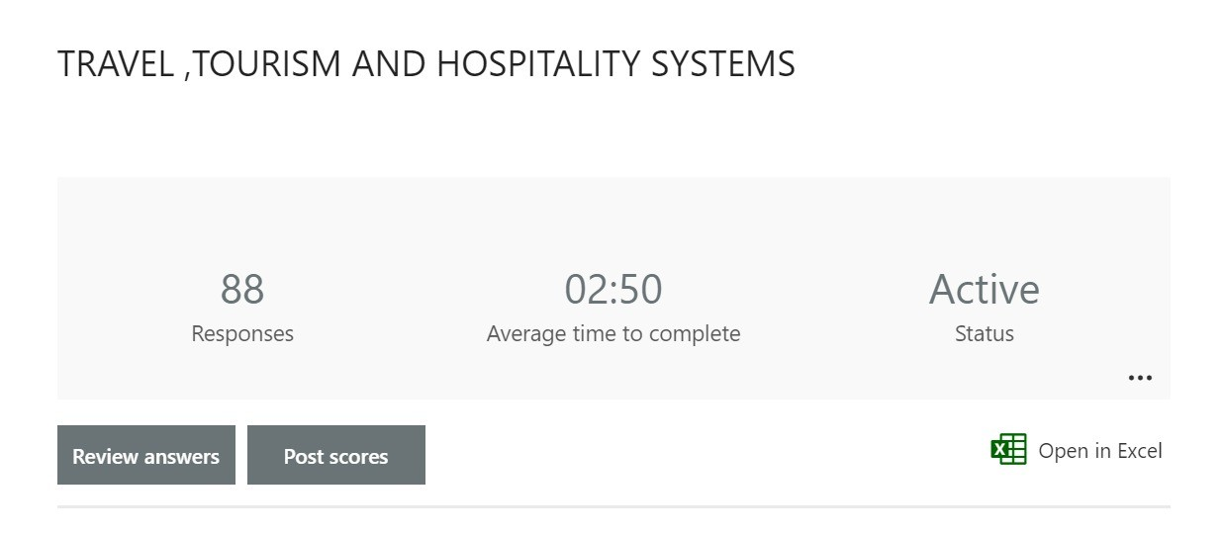
User Survey:

Slide 11
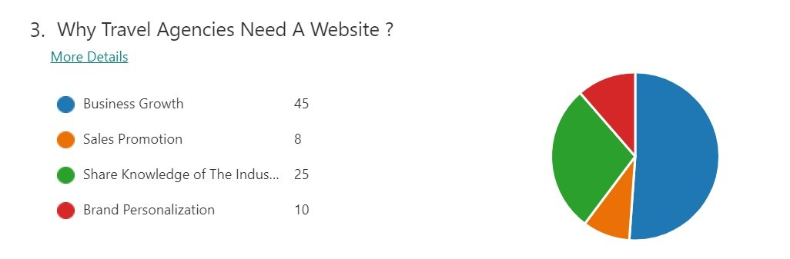
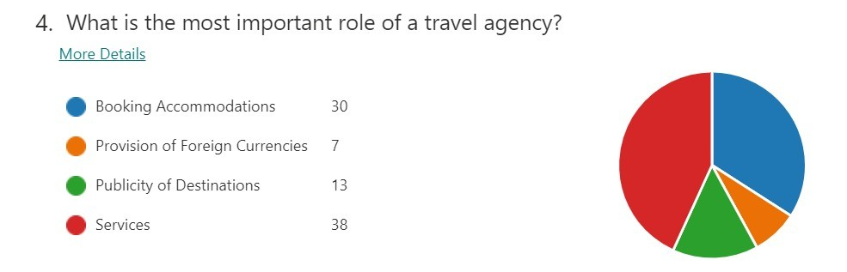

Slide 12
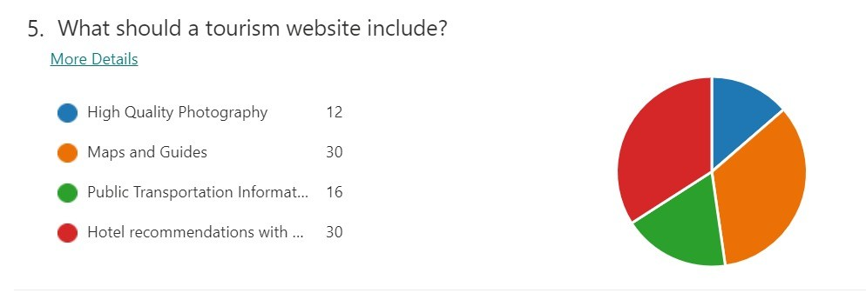
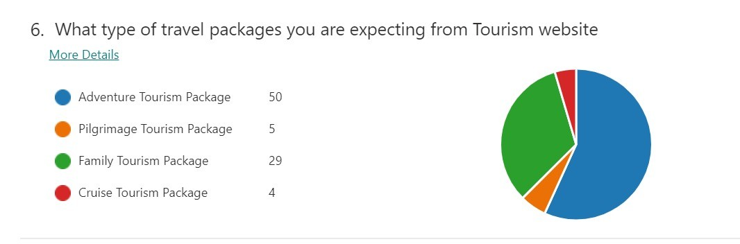

Slide 13
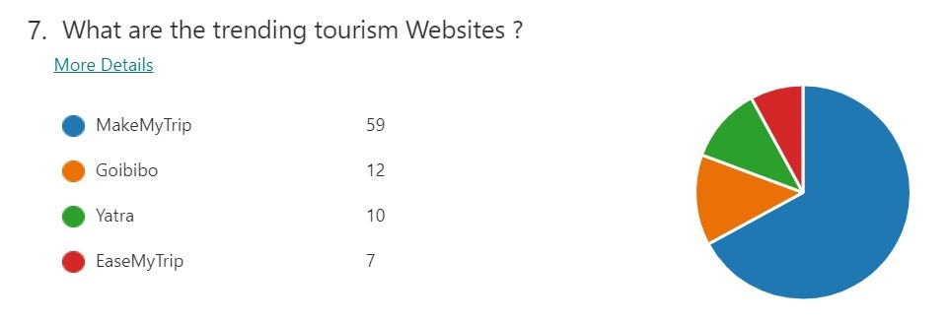
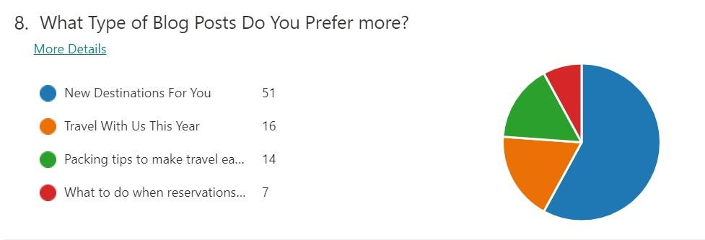

Slide 14

Understanding the business system:
The industry of travel and hospitality is witnessing massive changes and high competition. The sector has a very challenging and complex operational environment. The industry demands superlative customer experience and companies in this business strive hard to achieve customer loyalty and their following. Customers today want customized travel experiences and demand best levels of service. The customers can always choose from many options and go for the one that provides them better experience at a price lower than competition.

Slide 15
Today, customers shop themselves to find the best value for their money through different online options, and technology is helping them out by removing any information asymmetry. Companies can tap customers right at this juncture. We made solutions that can streamline IT infrastructure, help you drive customers, offer personalized services, boost customer retention, backed by responsive support, apps and processes automation, systematically maintain your staff for productivity, system and data security, and a lot more.
Our services for the travel and hospitality industry includes:
Inventory Applications
Content Management Systems
e-Commerce Services
Enterprise Mobility
ERP/CRM Services
Sales and Marketing Management
Help Desk Applications

Slide 16
Identification of problem statements:
Some of the problems that were faced by travel and tourism agencies:
Lack of Infrastructure
Safety and Security
Inaccessibility
Impact of coronavirus on Global Tourism
Lack of communication skills

Slide 17
Prerequisites:
React JS, Node JS, Express JS
Mongo DB
Elements Of Software Construction
Mathematical Programming, Knowledge on AI

Slide 18
User Stories:
As a user, I would like to search for flights and view the prices from starting city till destination city on a particular date so that I can make an informed choice and book a flight
As a user , I would like to select the flight of my choice , pre-book food options and pay for it online and get my e-ticket over email so that I can book everything required for my journey conveniently
As a vacation traveler , I want to see photos of the hotels
As a frequent flyer, I want to rebook a past trip so that I save time booking trips i take often.
As a Travel agent , I want my travelers to be satisfied with their trip so that they can give us a good feedback on our website

Slide 19
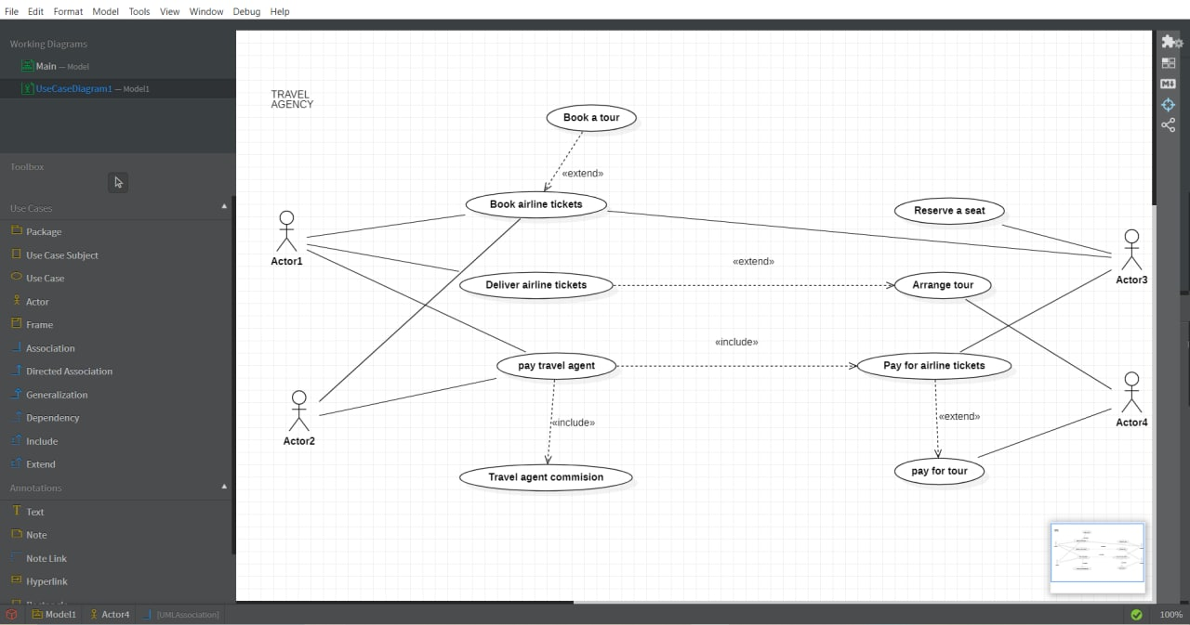
Use Case Diagrams:

Slide 20
Affinity Diagram:
React JS
ESC
DTI
DBMS
MP
USER INTERFACES
USER STORIES
EMPATHY MAP
USER INFO
ALGORITHMS
LOGIN PAGE
USE CASE DIAGRAMS
CUSTOMER JOURNEY MAPS
USER BOOKING
APPROXIMATIONS
APPOINTMENTS
MILESTONES
PROTOTYPES
TRIP COST
OPTIMIZATIONS

Slide 21
GitHub Repositories and LinkedIn:
GitHub:
sri8135/Travel-tourism-and-hospitality (github.com)
LinkedIn:
https://www.linkedin.com/pulse/travel-tourism-hospitality-systems-kakarla-raga-sri-lakshmi/?trackingId=CgRZloDPR06rCXRxaG7Ohw%3D%3D

Slide 22
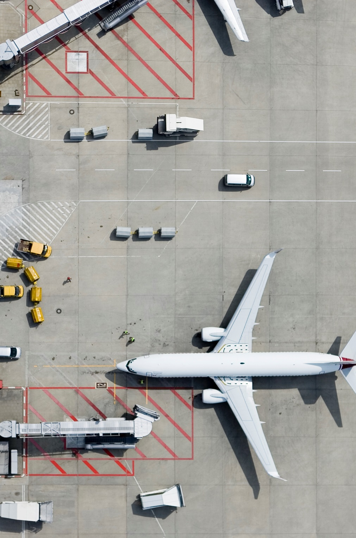
Transportation
Car
Ride Share
Taxi
Rental
Air
Int.
Domestic
Rail
Railway

Slide 23

Thank You
KAKARLA RAGA SRI LAKSHMI
NARAPARAJU SAI LASYA

